Slide 1
1 Planed
Planed 1
Finish the study of week02-week03.
Finish the project3 x64 code.
Finish the assignment1 and assignment2.
4

Slide 2
1 Results
Results 1
Finish the all of the plans.
4

Slide 3
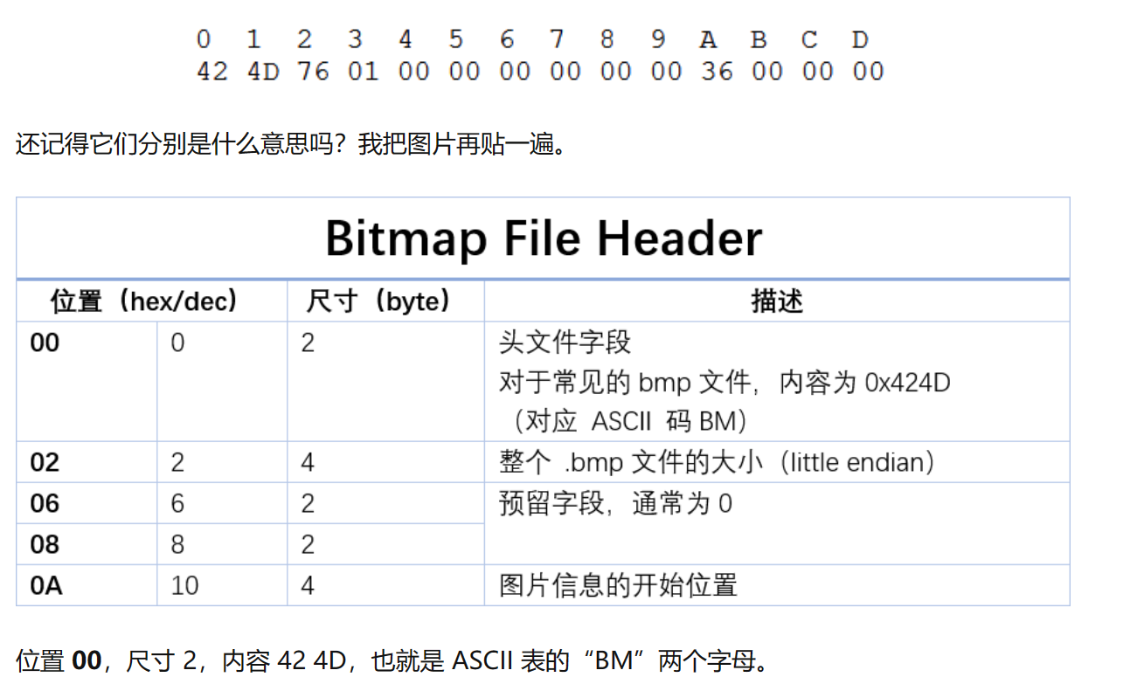
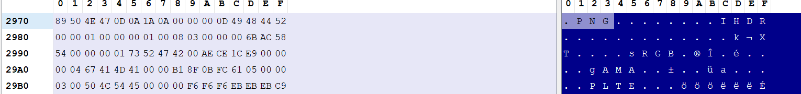

1 Challenges and Solutions
Challenges and solutions 1
The diagram is stored by the format `.png` not `.bmp` so I think not all the resources is stored by Bitmap.
Maybe that is why last week I failed to convert the file ‘.BMP’ to ‘.PNG’.
It does not take me lots of time to study the basic knowledge of `.BMP` and bitmap, I wander if I need to dive to it?
4

Slide 4
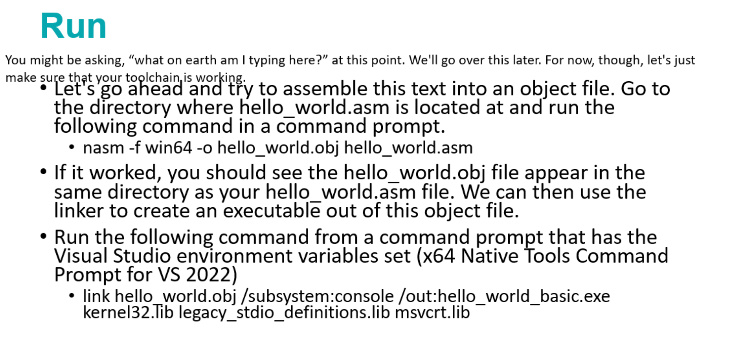
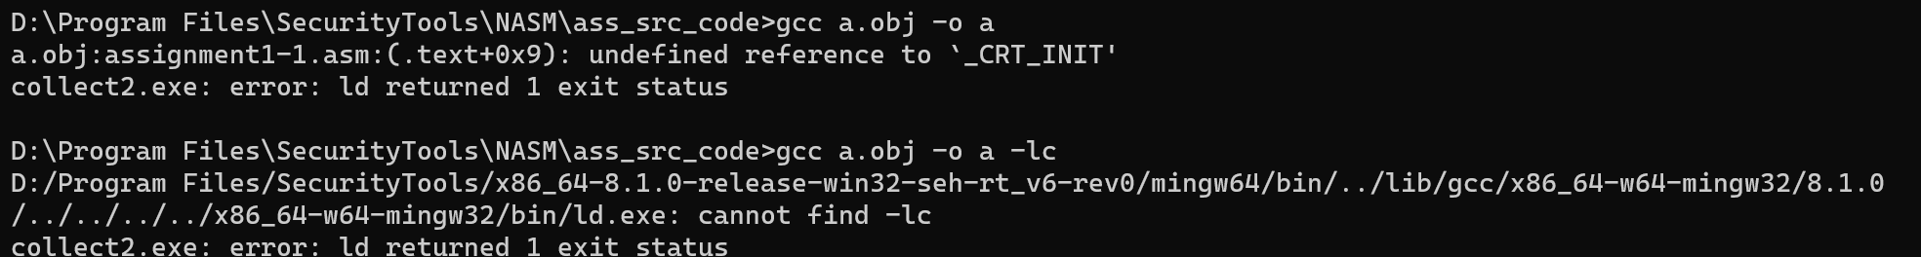
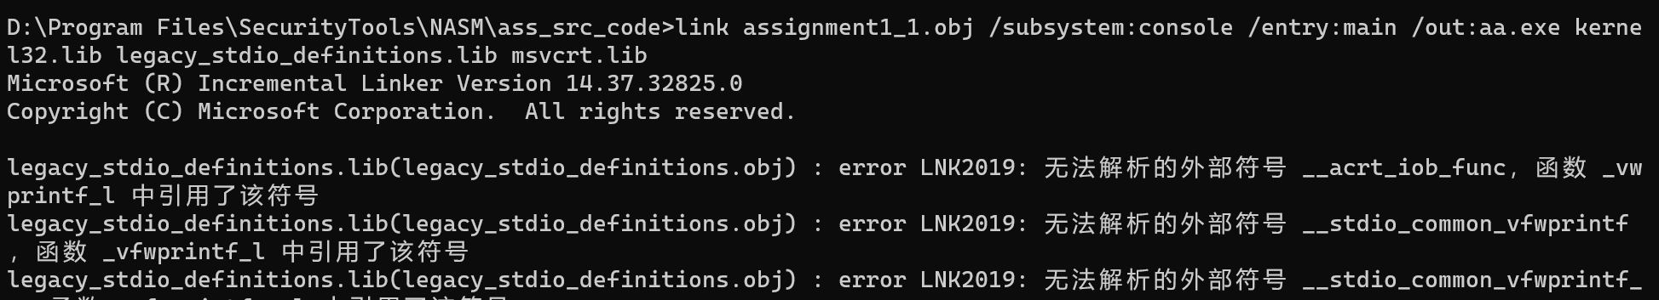


1 Challenges and Solutions
Challenges and solutions 1
I input this command but still error.
4

Slide 5
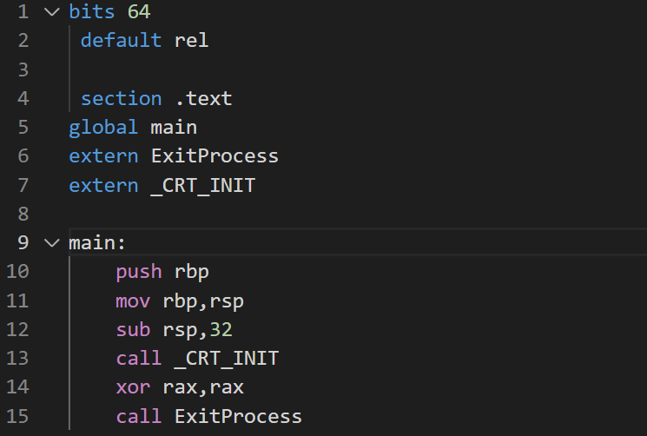

1 Challenges and Solutions
Challenges and solutions 1
😔 there is also a problem about my gcc!!!! Maybe it can’t link the C runtime lib.
I think it is the same reason that the `link` doesn’t work!!!
2023/11/21, after I finish my study plan I have to solve it…
4

Slide 6
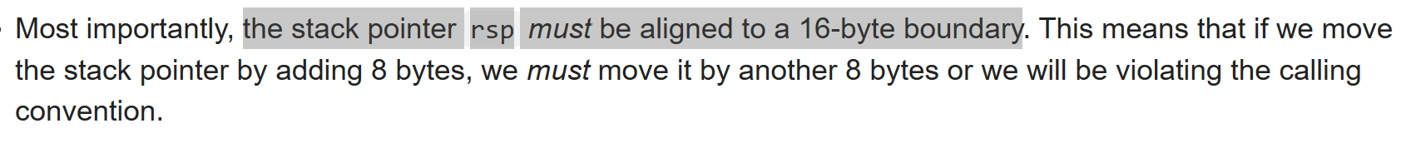

1 Challenges and Solutions
Challenges and solutions 1
Why it is aligned to a 16-byte boundary in x64?
In x64 the size of the pointer is 8 bytes, but the rsp is aligned to a 16-bye boundary, why?
4

Slide 7
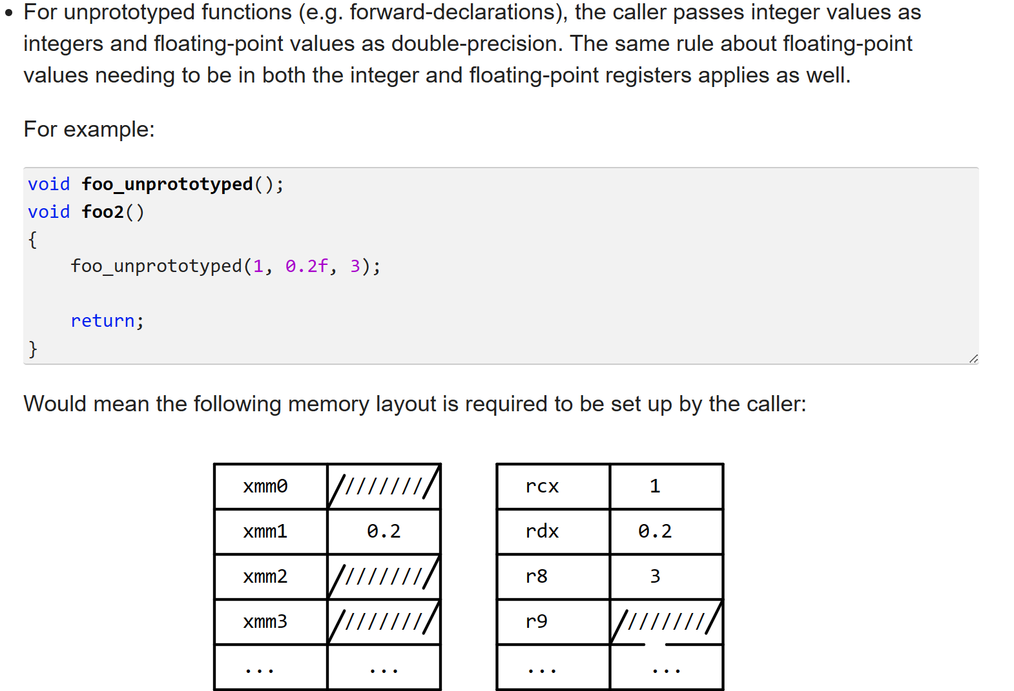
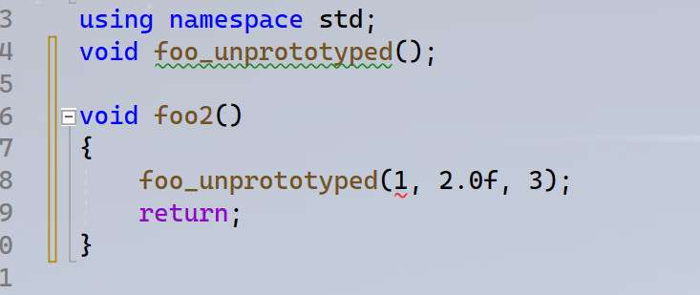
1 Challenges and Solutions
Challenges and solutions 1
The example code causes a error, so I can’t test what the tutorial talks is right or not. The error code is E0140.(visual studio 2022)
4

Slide 8
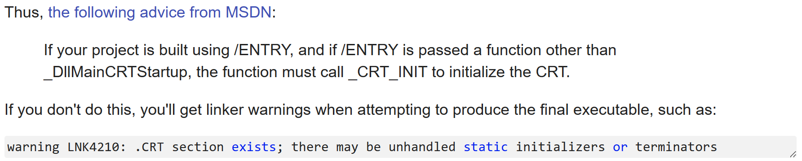
1 Challenges and Solutions
Challenges and solutions 1
What is the ‘/ENTRY’ ? Is it a function? What is the feature of it?
Maybe it is a parameter which is used to change the entry point of the program. And if we use it, this may cause a problem that the global and static variable can’t be initialized.
Why?
4

Slide 9
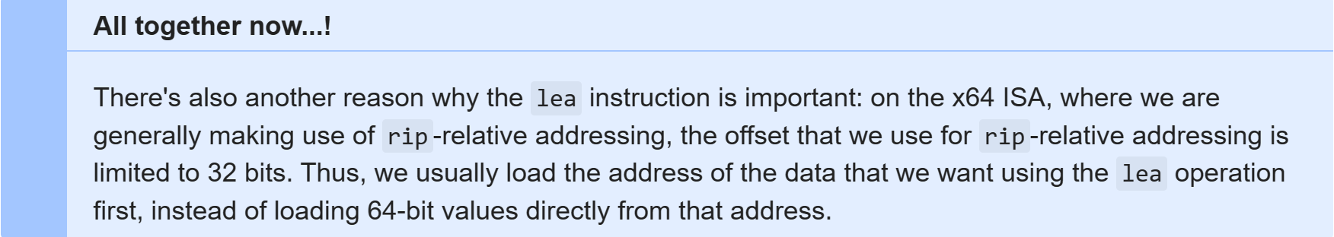
1 Challenges and Solutions
Challenges and solutions 1
In x64 ISA, it follows this format `address + offset` to address some data, and it says that “the offset that we use for rip-relative addressing is limited to 32 bits ” .It means the space(function stack) that the OS allocates to a function limits 2^32 bits?
4

Slide 10
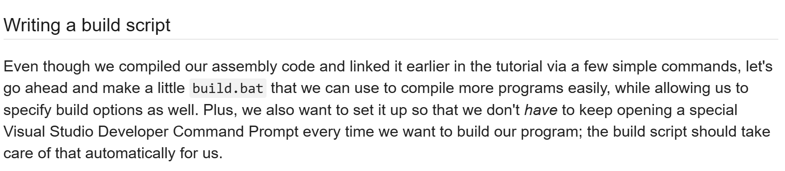
1 Challenges and Solutions
Challenges and solutions 1
If I want to make clear how to write a build script , it will take a lot of time, and I think now I do not need to learn Windows Script Language. So I just glance over this part.
4

Slide 11
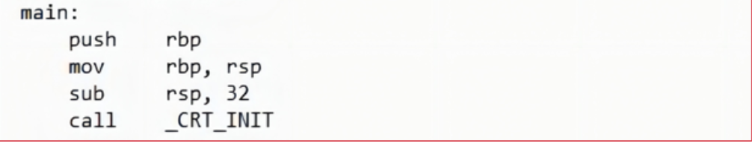
1 Challenges and Solutions
Challenges and solutions 1
I found that you call the function `_CRT_INIT` in your code.
I know, the function `_CRT_INTI` is used to initialize variable, environment…before the program executes.
In my code, I don’t do that but the program execute successfully, I think user doesn’t need to call the function in some program, right? What is `_CRT_INIT` usually used for?
4

Slide 12
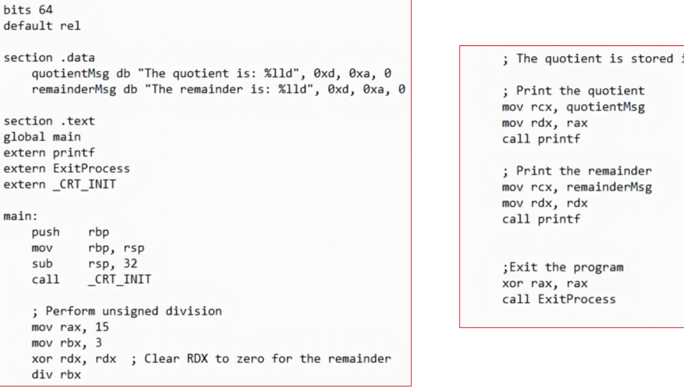
1 Challenges and Solutions
Challenges and solutions 1
There is some problem in this code.
The first line it prints 5 but the second line will not the 0
The next slide is my code that can print the Quotient and remainder.
I think the reason is that after printing the quotient the remainder stored in the rdx is changed. So I can’t print the remainder `0`.
4

Slide 13
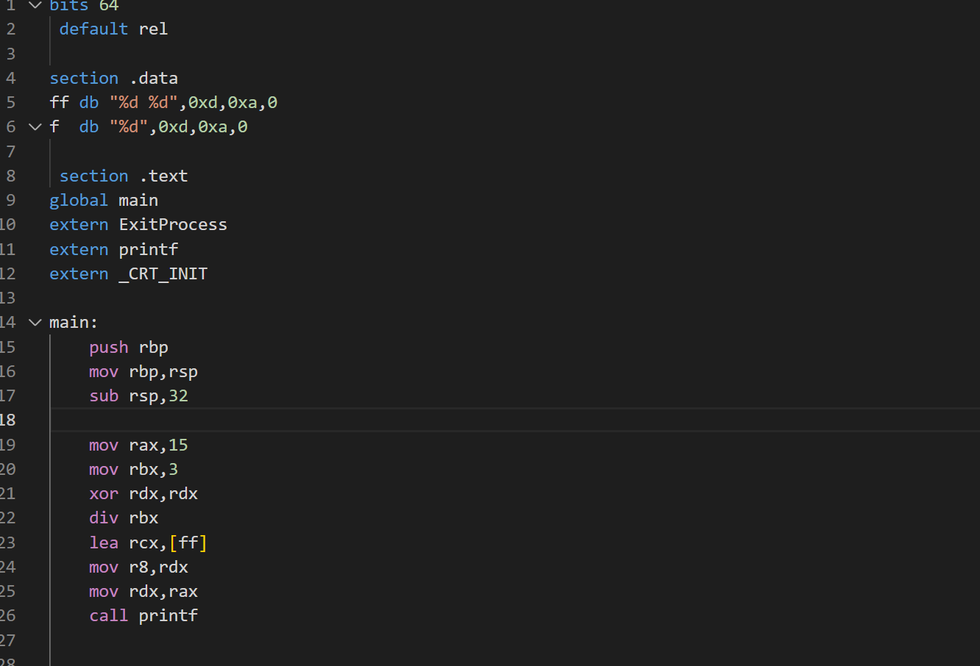
1 Challenges and Solutions
Challenges and solutions 1
4

Slide 14
1 Plan
plan 1
Solve the problem in this slides
Finish the study of week04(this week finish the study of Assembly Basic)
Finish the Quiz1 and Assignment3
4

